Slide 1
TIQBio updates Feb-March
Simon

Slide 2
Needs of AZ
Cancer Model
Cell/spheroid viability
Tumour size
Morphology
Cell death/apoptosis
Proliferation
Metabolism
ECM deposition
Non-Cancer Model
Fibrosis
Regeneration
Interested in
High throughput
Lower requirement for sample prep (label-free!)

Slide 3
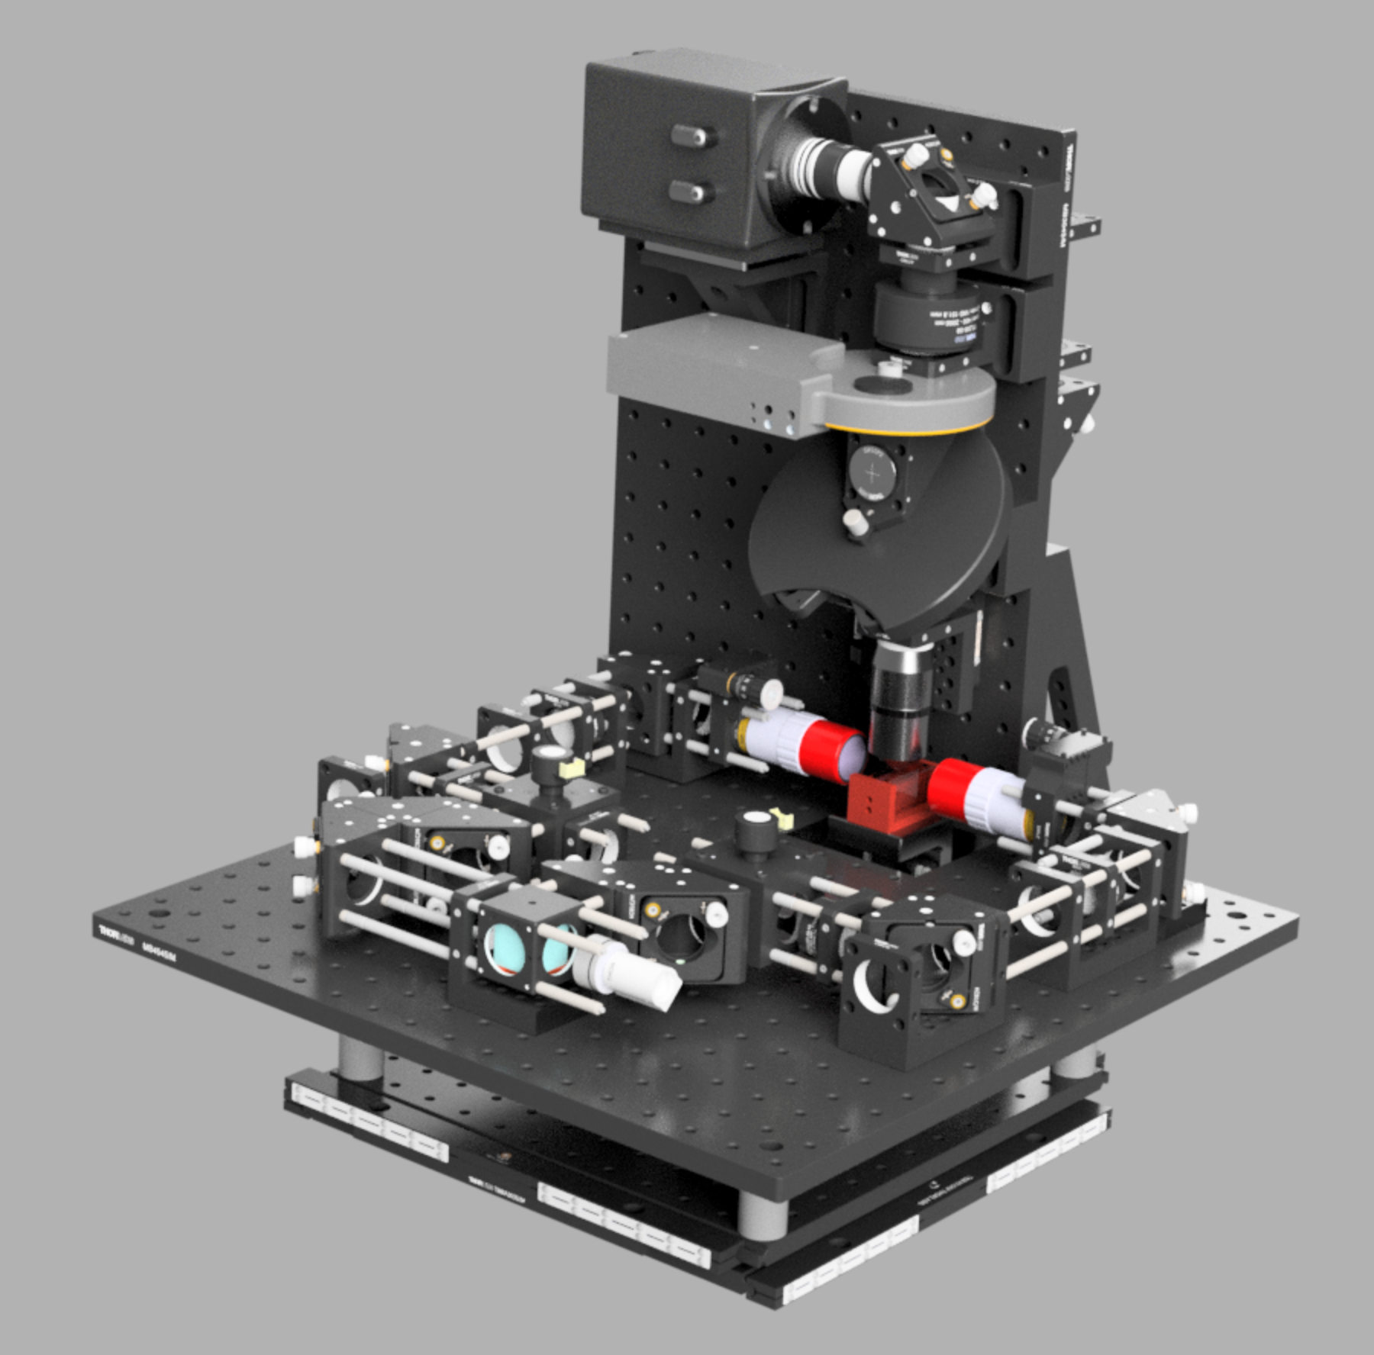
Dual–illumination lightsheet
Designed Full system in CAD
Ordered: Optical components, Camera, Objectives, Stage.
To Do:
Build system (parts still arriving)
Electronics, Firmware and synchronisation
Software

Slide 4
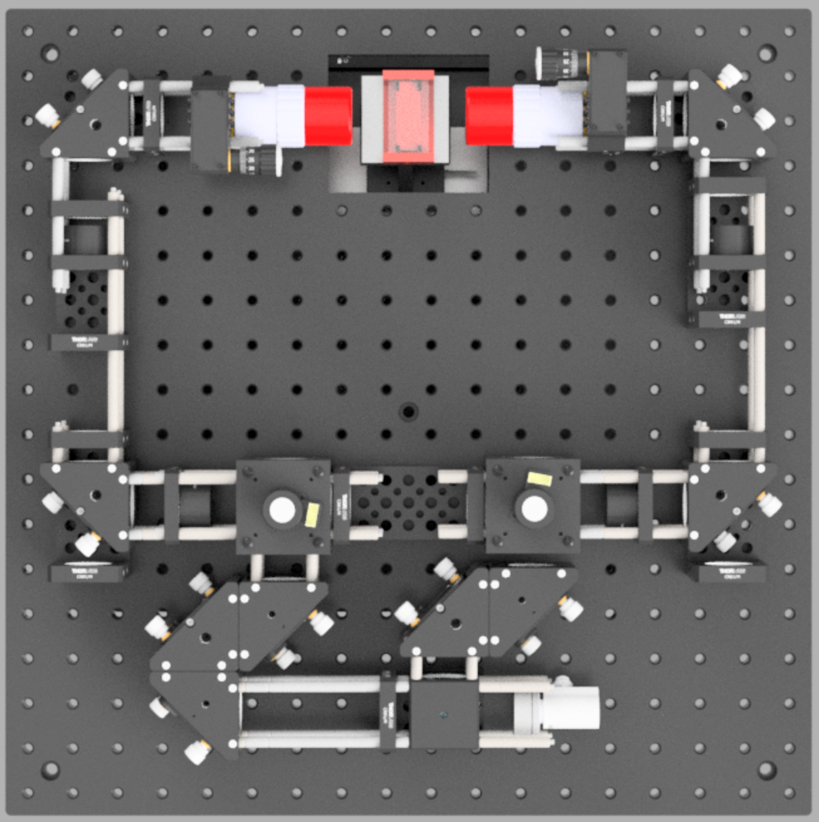
Illumination
10x 1NA objectives
Sample chamber
3x beam expander / scan-tube lens
Gavlo scanner
50:50 beam splitter
Reflective collimator

Slide 5
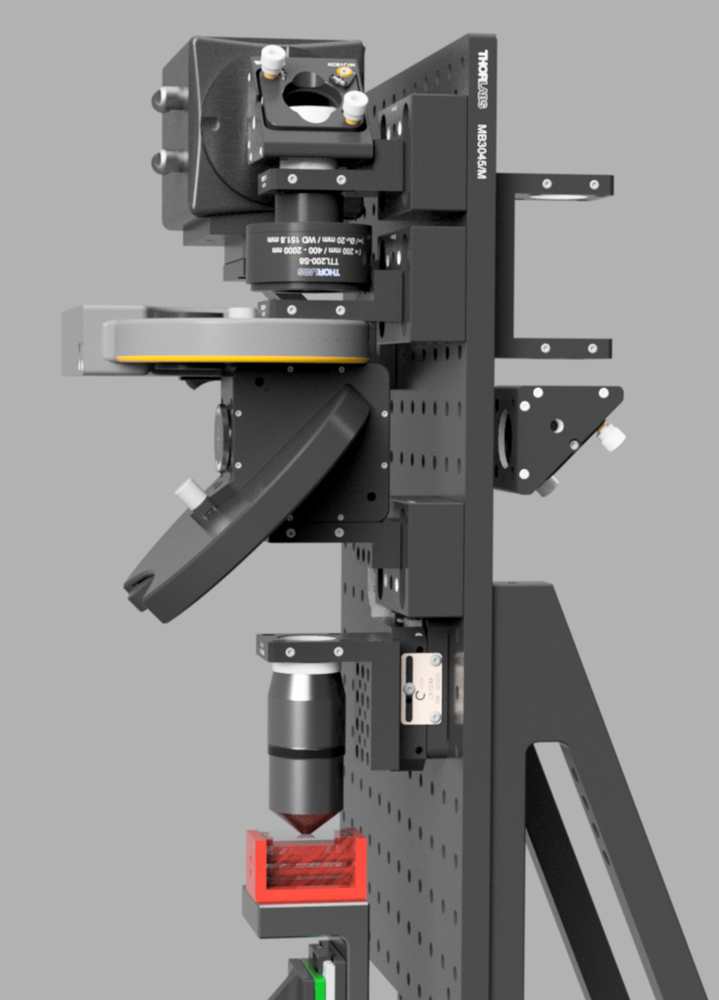
Detection
1NA 20x
Epiflourescence, or other illumination possible
Automated filter wheel
Hamamatsu camera (High QE)
100Hz imaging

Slide 6
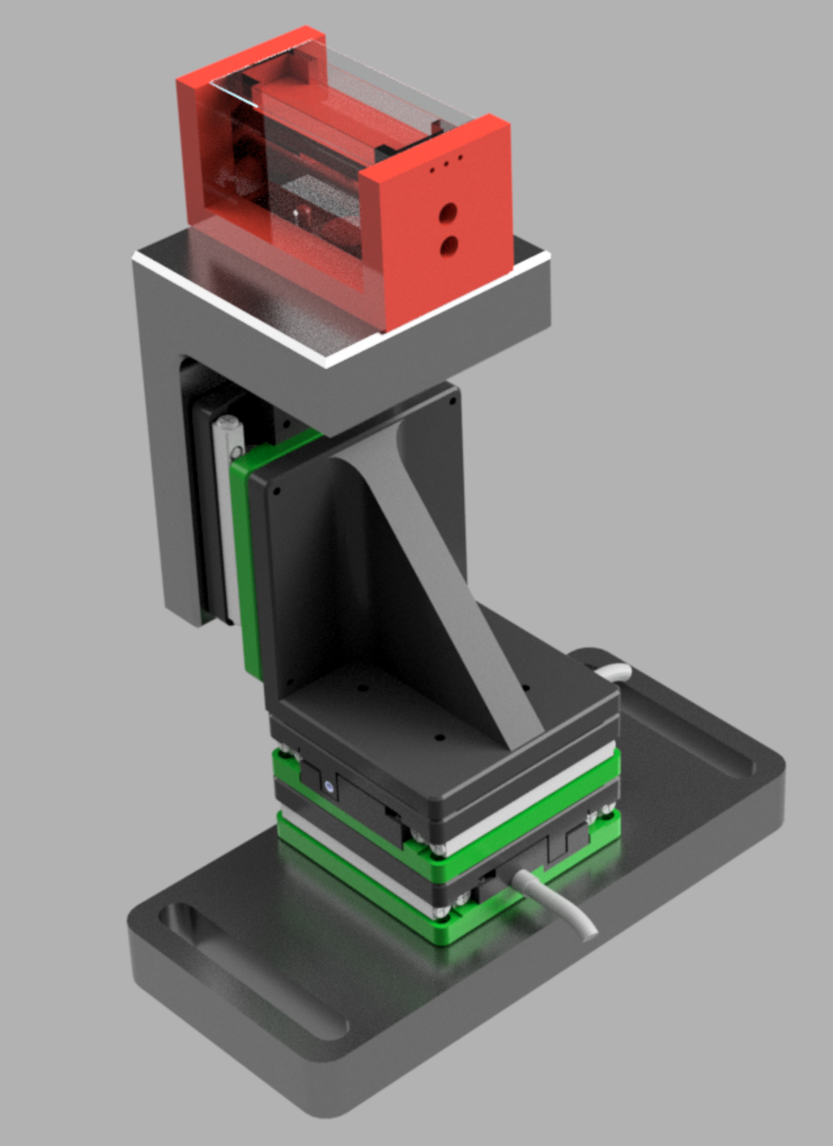
Stage + sample chamber
Multiple samples (up to 10?)
Heated
Piezo movement (20mm range)

Slide 7
PCIe
PC
Camera A
Digital Out
PCIe
Digital Out
Camera B
USB
Filter Wheel
USB
Stage Controller
USB
Stage X
Digital Out
USB
Stage Y
Digital Out
Digital Out
USB
Stage Z
Digital Out
µC
Galvo A
OpAmp
Analog Out
SPI Dual DAC
Galvo B
OpAmp
Analog Out
Analog Out
SPI Dual DAC
Laser AOTF
Analog Out
Analog Out
SPI Dual DAC
Analog Out
Supercontinuum
µC
Environmental
TBD

Slide 8
